Slide 1














Customer Churn Analysis and Recommendations
Leveraging Data Insights to Enhance Customer Satisfaction

Slide 2
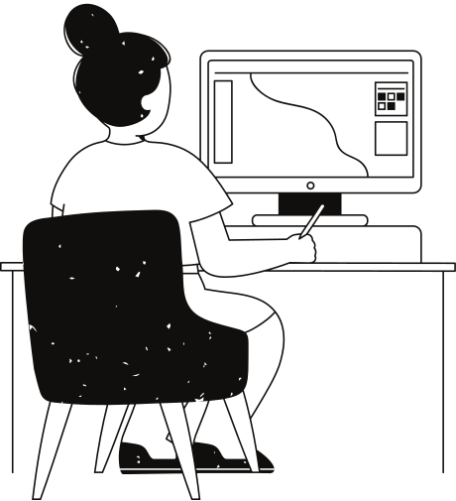
A bank is a financial institution that is licensed to accept checking and savings deposits and make loans. Banks also provide related services such as individual retirement accounts (IRAs), certificates of deposit (CDs), currency exchange, and safe deposit boxes.
A bank is a financial institution that is licensed to accept checking and savings deposits and make loans. Banks also provide related services such as individual retirement accounts (IRAs), certificates of deposit (CDs), currency exchange, and safe deposit boxes.

Slide 3
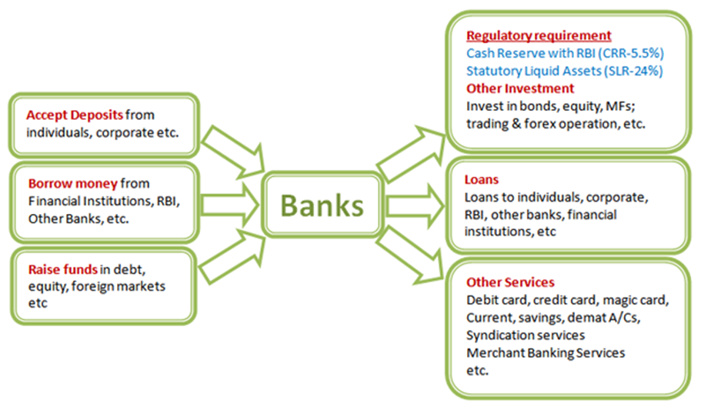
Working of banks
Welcome, everyone. Today, we'll delve into the critical task of understanding and reducing customer churn for our bank. As an analytical CRM specialist, my aim is to present actionable insights derived from our customer-related datasets. By leveraging these insights, we can not only reduce churn but also improve service delivery and enhance overall customer satisfaction.
In this presentation, we'll explore the factors contributing to customer churn, analyze customer demographics and behavior, and provide recommendations for decreasing churn and improving service. Let's dive in.

Slide 4

Capstone Bank’s Data Snapshot
CustomerId: A unique identifier for each customer.
CreditScore: A numerical representation of the customer's creditworthiness.
Credit score:
Excellent: 800–850
Very Good: 740–799
Good: 670–739
Fair: 580–669
Poor: 300–579
Tenure: The number of years the customer has been with the bank.
Balance: Current balance in the customer's account.
NumOfProducts: refers to the number of products that a customer has purchased through the bank.
HasCrCard: denotes whether or not a customer has a credit card. This column is also relevant, since people with a credit card are less likely to leave the bank.
1 represents credit card holder
0 represents non credit card holder

Slide 5
IsActiveMember: active customers are less likely to leave the bank (as per the criteria defined by the bank for identifying the activeness).
1 represents Active Member
0 represents Inactive Member
Exited: whether or not the customer left the bank.
0 represents Retain
1 represents Exit
Age: The age of the customer.
Estimated Salary: as with balance, people with lower salaries are more likely to leave the bank compared to those with higher salaries.
GeographyID: A numerical identifier that likely corresponds to a geographical location, such as a country or region.
GenderID: A numerical identifier for the customer's gender, where for example, '1' could represent male and '2' could represent female.
Bank DOJ: date when the Customer associated/joined with the bank.
This data set allows for an in-depth understanding of Capstone bank's demographics, transaction details, customer exit information and active customers profiles.
High quality data is crucial for analyzing customer behavior, spending patterns and customers satisfaction with the bank.
Insights from analyzing customers tenure, balances, estimated salaries, credit score and activity are useful customer exit patterns.

Slide 6
Analytical Approach and Tools
Data Import:
Converted the excel files into csv files and imported the csv files onto MySQL Database
Imported the data into Power BI desktop from MySQL database
Data Cleaning:
Renamed HasCrCard column into Has_creditcard for clear understanding
Created a new column as CustomerID_Surname for combining with a column to another table's primary key of same format
Data Enrichment:
Added conditional columns for customer's tenure categorization and customer's age segmentation
Created a calculated column for credit score segmentation from Column tools - Data groups
Created calculated columns for flagging the churn risk and outliers and for finding the z-score
Descriptive analysis:
Created calculated measures using DAX formulas for Acquisition Rate, Active Credit Card Users, Average Balance, Balance to Salary Ratio, Churn Rate, Retention Rate, Total Revenue, Average Estimated Salary etc.
Visualization:
Created dynamic charts and dashboards for data representation, enabling interactive data exploration

Slide 7
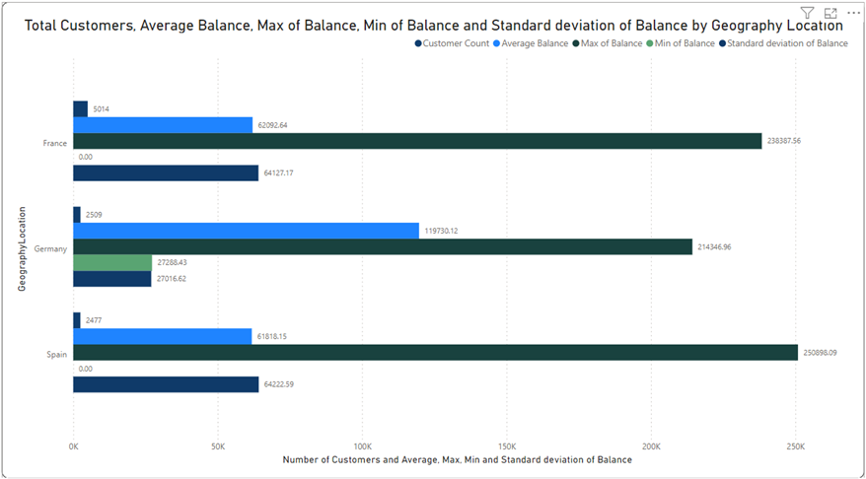
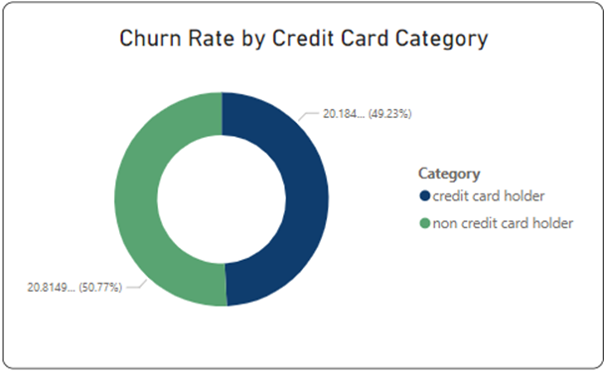
This clustered column chart provides us the distribution of account balances across different regions which helps us how the amounts of money held in bank accounts are spread out among various geographical areas
Less number of customers in Spain and Germany than in France
The average balance is lower in Germany than in France and Spain
There is very little deviation in the maximum balance across the regions
The minimum balance is zero in both France and Spain and 27288.3 in Germany
The standard deviation is lower in Germany than in France and Spain
This donut talks about the impact of having a credit card on customer churn, based on the available data
Having a credit card is associated with a slightly lower churn rate.
Having a credit card may slightly reduce the likelihood of churn.
The difference in churn rates between having and not having a credit card is relatively small.
Other factors may also play a significant role in determining churn behaviour.

Slide 8
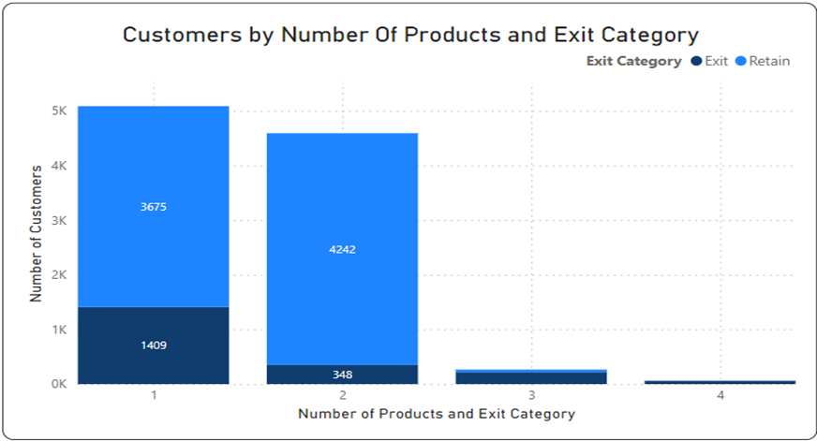
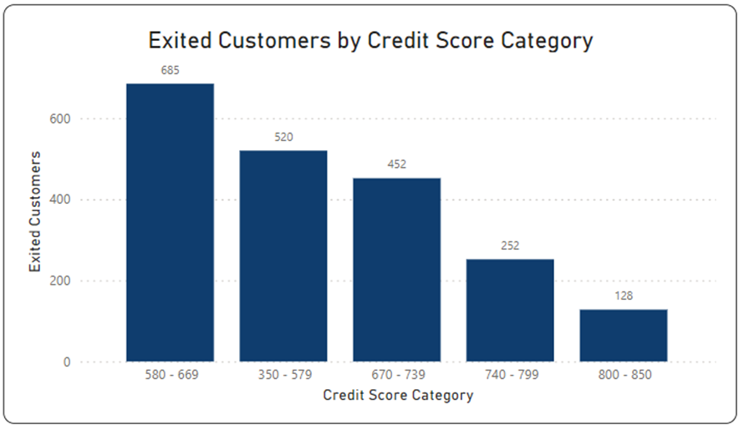
This stacked bar chart gives insights into the most common number of products they have used for customers who have exited which will help us understand if there's any discernible pattern or correlation between the number of products and the exit rate
For Product 1: 1409 exited out of 5084
For Product 2: 348 exited out of 4509
For Product 3: 220 exited out of 266
For Product 4: 60 exited out of 60
The most common number of products purchased by exited customers was 1 and the most common number of products purchased by all customers.
This column chart shows the number of customers for each credit score range who have exited
Exited customers having a credit score from 580 to 669 are the highest
Exited customers having a credit score from 800 to 850 are the lowest
Customers with higher credit scores seem to have slightly lower exit rates. This could imply that building financial stability reduces the likelihood of churn

Slide 9
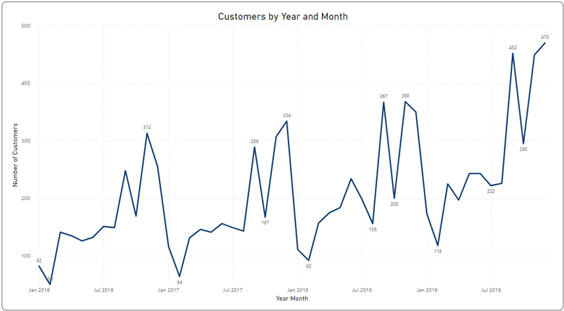
This line chart provides us with the trend of customers joining over time which will us to identify any seasonal patterns (yearly or monthly)
Overall Trend:
The number of customers who joined seems to have increased over the years, with some fluctuations.
There is a general upward trend from 2016 to 2019, indicating business growth over time.
Yearly Seasonality:
Each year shows a similar fluctuation pattern, with more customers joining towards the end of each year (November and December), followed by a decrease in January of the next year. This might be attributed to seasonal factors like holidays or year-end promotions.
There's a notable increase in customers joining during September of each year, except for 2016, which could be due to specific marketing campaigns or seasonal trends.
Monthly Patterns:
Looking at individual months, we can see some variability in the number of customers joining, but certain months consistently have higher or lower numbers.
For example, November and December tend to have the highest numbers of customers joining, while January and February usually have lower numbers.
There are fluctuations throughout the year, but no consistent trend for every month across all years.

Slide 10
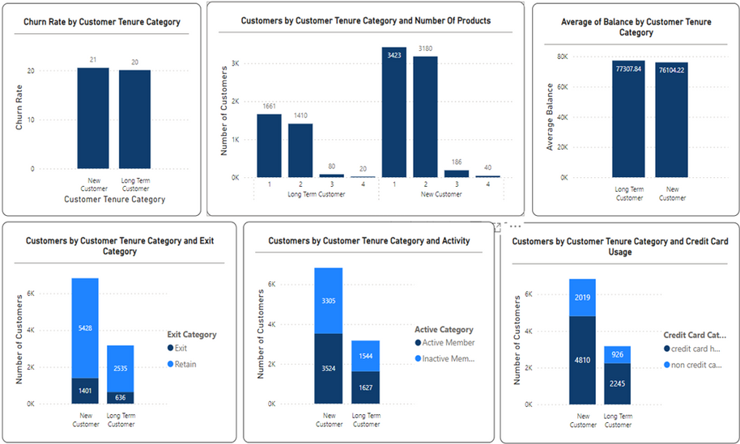
Spending Patterns Across Customer Tenure: New vs. Long-term
This report here represents the customer’s behaviour patterns in terms of spending for both new and long-term customers, these patterns help us to get the details about customer loyalty
Number of Products:
Long-term customers purchase fewer products across all categories compared to new customers.
Indicates settled preferences or specific needs among long-term customers, while new customers are still exploring.
Average Balance:
Long-term customers have a slightly higher average balance compared to new customers.
Suggests higher trust or commitment among long-term customers, leading to larger account balances over time.
Customer Exits:
New customers have a higher rate of exiting compared to long-term customers.
Indicates potentially lower satisfaction or commitment among new customers, resulting in higher churn rates.
Customer Activity:
Long-term customers are more likely to be active compared to new customers.
Shows higher engagement among long-term customers, possibly due to established relationships and satisfaction.
Credit Card Usage:
Long-term customers are more likely to have credit cards compared to new customers.
Implies higher trust and willingness to engage in financial transactions among long-term customers, potentially leading to increased loyalty.

Slide 11
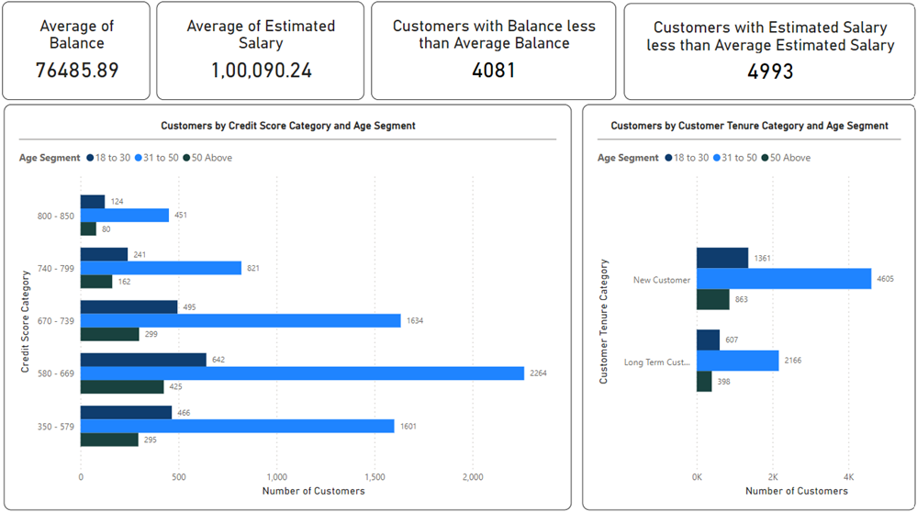
Product Affinity Study & Risk Management Assessment
This report helps us identify which demographic segments appear to pose the highest financial risk to the bank based on customer profiles, and why
Credit Score and Age:
Customers with lower credit scores and younger age might pose higher financial risks as they could have less financial stability and experience managing their finances.
Tenure and Age:
Newer customers, especially younger ones, might be riskier as they may not have established a long-term relationship with the bank yet.
Balance and Estimated Salary:
Customers with lower balances and salaries might be more prone to financial difficulties, increasing the risk of default or leaving the bank.

Slide 12
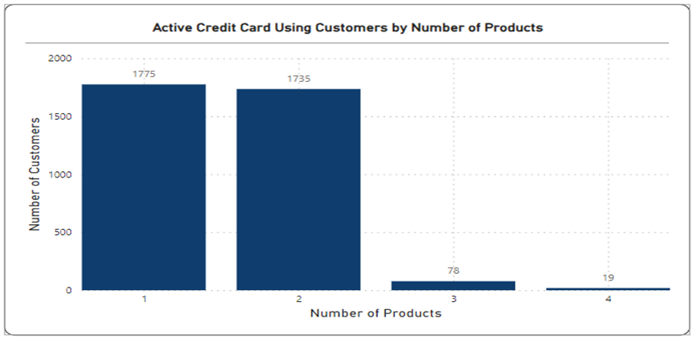
This report helps us identify which bank products or services are most commonly used together, and how might this influence cross-selling strategies
The customers frequently using a credit card, might also be interested in other banking products like personal loans or investment accounts.
The active members tend to have multiple products, so offering incentives or rewards for bundling additional services could be effective in retaining these customers.

Slide 13
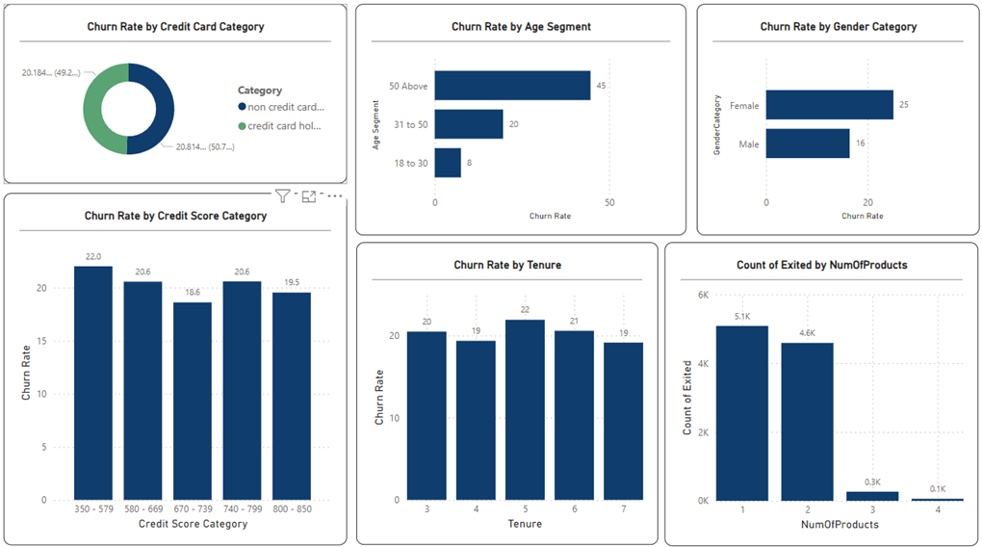
Customer Exit Reasons Exploration
This report provides insights into common characteristics or trends among customers who have exited that could explain their reasons for leaving
Low Credit Score: Customers with lower credit scores tend to have higher churn rates. This could indicate that customers with poor credit scores may face financial difficulties, leading them to exit.
Gender: Female customers have a higher churn rate compared to male customers. This difference could be due to various factors such as different financial needs or experiences.
Non-Credit Card Holders: Customers who do not hold credit cards have a slightly higher churn rate compared to credit card holders. This could suggest that those without credit cards might have limited financial flexibility or access to certain services, leading them to churn.

Slide 14
Number of Products: Customers with fewer products (likely banking or financial products) have higher churn rates. This could imply that customers who have a limited relationship with the bank are more likely to leave.
Age Above 50: Surprisingly, customers aged 50 and above have a significantly high churn rate. This may be due to changes in financial needs, relocation, or retirement.
Credit Score and Tenure Interaction: While there isn't a direct correlation between tenure and churn rate, customers with longer tenure and higher credit scores seem to have slightly lower churn rates. This could imply that building a longer-term relationship and financial stability reduces the likelihood of churn.
Churn Rate by Tenure: There isn't a clear trend in churn rate based on tenure alone, but it's worth noting that customers with a tenure of 5 years have a higher churn rate compared to other tenures. This could indicate a potential dissatisfaction or need for revaluation of services around the 5-year mark.
In summary, customers who have exited tend to be older, have lower credit scores, and have fewer banking products. However, there are also interesting variations based on gender, age, and credit card usage.

Slide 15

Recommendations:
Targeted Communication: Personalized communication and offers for at-risk customers.
Retention Incentives: Customers who are above 50 years of age are more inclined to exit the bank. Special offers and rewards for older customers and those with lower credit scores or balances.
Product Enhancement: Introduce new products tailored to specific customer segments.
Customer Service: Customers with low balances and estimated salaries are more susceptible to exiting the bank. Focus on excellent service and proactive outreach to address concerns.
Credit Card Promotion: Customers who do not hold credit cards are more inclined to exit the bank. Encourage credit card adoption with benefits and rewards.
Product Bundling: Customers with fewer products are more predisposed to exit the bank. Offer discounts for using multiple bank services.
Financial Education: Provide resources to improve financial literacy and promote loyalty.
Retention Campaigns: Targeted campaigns based on segmentation and behavior analysis.
Feedback Collection: Regularly gather feedback to improve products and services.
Relationship Building: Customers with a 4-to-5-year tenure are more predisposed to exit the bank. Foster long-term relationships through reliability and trustworthiness.
By implementing these strategies, the bank can effectively reduce churn rates and improve customer retention, leading to increased customer satisfaction and loyalty.

Slide 16
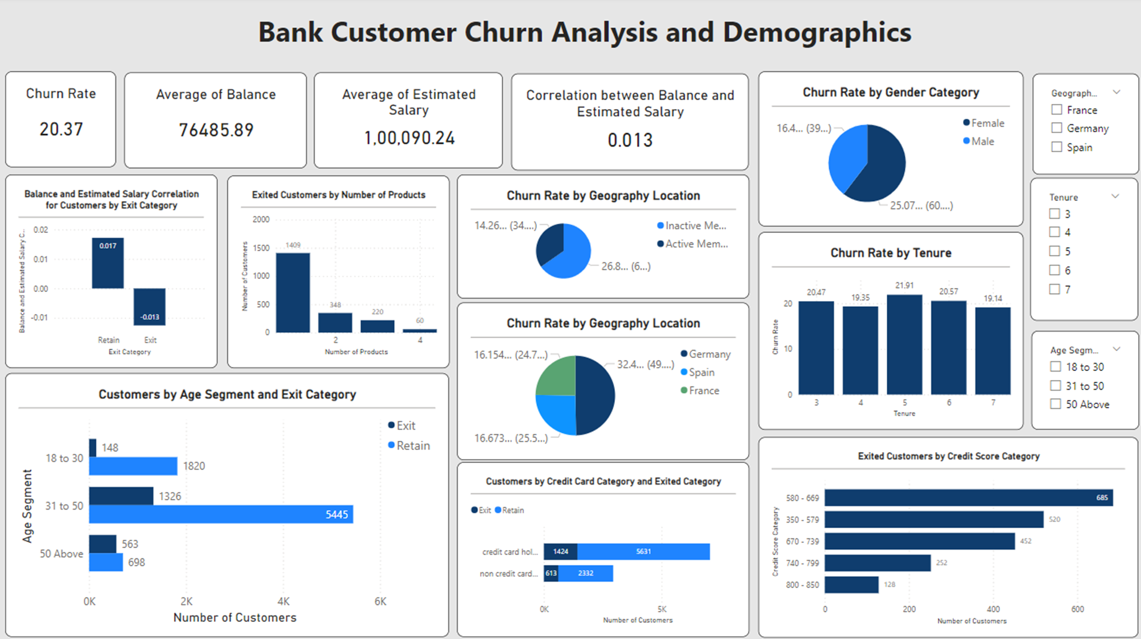

Slide 17
Thank you very much!

